Slide 1

Moving Beyond Linearity:
Polynomial Regression, Step Functions
and Basis Functions
Team Mu (2-12)
Claire Duchene, Giorgi Lomaia, Joshua Swerdlow, and Trace Zhang

Slide 2
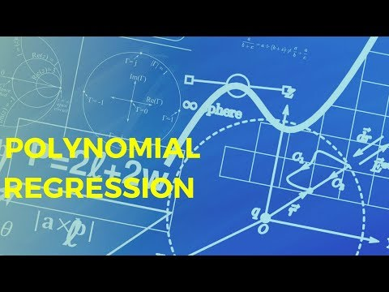
Intro to Polynomial Regression

Slide 3
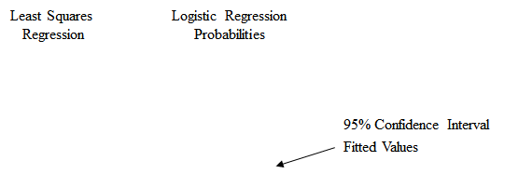
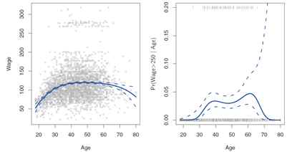
Polynomial Regression
Recall that we replace the standard linear model with the following:
For step functions and basis functions: we are in a one-predictor case
For large enough degree d, a polynomial regression allows us to produce an extremely non-linear curve.
Observations:
Generally speaking, it is unusual to use d greater than 3 or 4 because for large values of d, the polynomial curve can become overly flexible and can take on some very strange shapes.
This is especially true near the boundary of the X variable, where there may be few observations – see above.
Notes:
Emphasize one predictor and
how multiple coefficients with stay the same wile d changes
Confidence interval grows as d increases
Polynomial linear bc coefficients are linear in relationship to one another

Slide 4
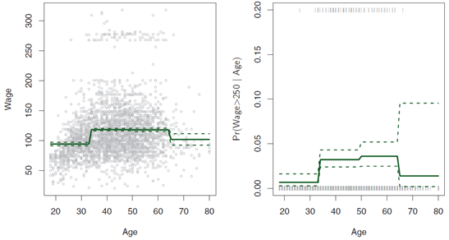
Step Functions
Unless there are identifiable breakpoints in the predictors that define very different behavior in the response, this piecewise-constant approach can miss the action (see example)
For example, observe in the left-hand panel above that the first few bins clearly miss the increasing trend of wage with age due to the gradual change in wage as age increases.

Slide 5
Step Functions
Using polynomial or linear functions imposes a global setting on the entire subspace spanned by the predictors
We can instead use step functions to break the range of X into bins, and fit a different model in each bin
That is, use a “piecewise-constant’ approach
This amounts to converting a continuous variable into an ordered categorical variable.

Slide 6
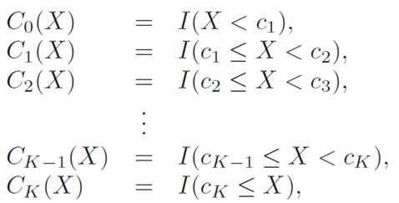
Step Functions
We create “cutpoints” c₁, c₂, . . . , c_{K} in the range of X, and then construct K + 1 new variables, as follows:
where I(·) is an indicator function that returns a 1 if the condition is true, and a 0 otherwise
We can optimize the number and placement of cutpoints using a tuning parameter such as a cross-validated MSE

Slide 7
Step Functions
Observe that for any value of X, C₀(X) + C₁(X) +. . .+ C_{K}(X) = 1, since X must be in exactly one of the
K + 1 intervals.
We then use least squares to fit a linear model using C₁(X), C₂(X), . . ., C_{K}(X) as predictors:
Note that when X < c₁, all of the predictors in this expression are zero, so β₀ can be interpreted as the mean value of Y for X < c₁
Otherwise, the expression predicts a response of β₀+β_{j} for c_{j} ≤ X < c_{j+1}, so β_{j} represents the average increase in the response for X in c_{j} ≤ X < c_{j+1} relative to X < c₁
Notes:
Josh- Beta knot not beta 0
Write equations on board inst

Slide 8

Basis Functions
Polynomial and piecewise-constant regression models are in fact examples of a basis function approach
The idea is to have at hand a family of functions or transformations that can be applied to a variable X: bi(X), b2(X), … bk(X) instead of fitting linear models for variable X:
b₁(X), b₂(X), ... ,b_{K}(X)
Instead of fitting a linear model in X, we fit the model
Note that the basis functions b₁(·), b₂(·),..., b_{K}(·) are fixed and known. In other words, we choose the functions ahead of time

Slide 9
Basis Functions
For polynomial regression, the basis functions are b_{j}(xi) = xi^j ,
For piecewise constant functions they are: b_{j}(xi) = I(c_{j} ≤ x_{i} < c_{j}+1).
We can think of think of the expression
as the standard linear model with predictors: b₁(x_{i}), b₂(x_{i}), . . . , b_{K}(x_{i}).
Hence, all the inference tools for linear models that we have discussed so far are available in this setting.
There are many alternatives for basis functions – in the next section we investigate a very common choice for a basis function: regression splines.

Slide 10

Example
Suppose our sample is y = c(-1.02, -0.753, -0.35, -0.34, -0.68, -0.02, 0.54, -0.08, 1.07, 1.03, 0.32, 1.59, 1.4, 2.22, 1.36, 2.56, 2.67, 2.00, 1.93, 2.21, 0.58) with the domain of x = seq(-2, 2, 0.2) and we fit a curve with basis functions:
b1(X) = X
b2(X) = (X-1)^2 I(X >= 1)
We fit the linear regression model:
And obtain coefficient estimates B^0 = 1, B^1 = 1, B^2 = 2. Sketch the estimated curve.Note the intercepts, slopes, and other relevant information
Notes:
Explain equations / screenshot

Slide 11
Practice Problems
Suppose our sample is y = c(2.68, 1.34, 1.24, 1.5, 1.62, 2.04, 1.02, 3.64, 1.56, 3.93, 2.54, 1.95, 1.88, 1.06, 1.32, 3, 2.11, 2.14, 3.64, 15.16, 15.24) with the domain of x = seq(-5, 5, 0.5)
We fit a curve with basis functions:
b1(X) = I(0 <= X <= 2) - (X-1)I(1 <=X<=2)
b2(X) = (X-3)I(3<=X<=4) + I(4 <X<=5)
We fit the linear regression model:
We fit the linear regression model and obtain coefficient estimates B^0 =1, B^1 =1, B^2=3
Sketch the estimated curve between X= -4 and X= 4. Note the intercepts, slopes, and other relevant information

